Slide 1
Options Trading Competition
Week 7

Slide 2
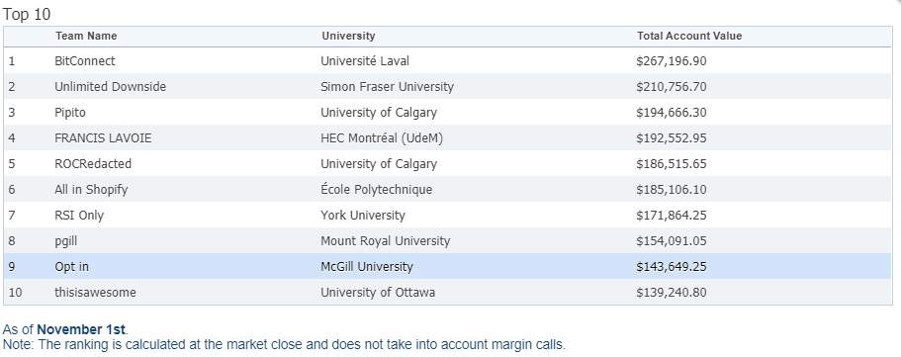
What Happened Last week:
We have dropped to ninth place.
Closed CM, RY, and TECK positions.
Got margin called
New strategy revealed

Slide 3
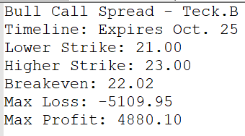
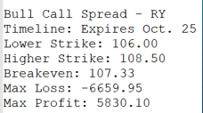
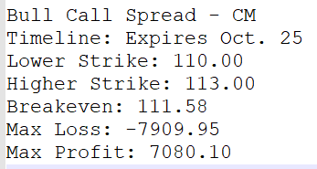
New positions last week:

Slide 4
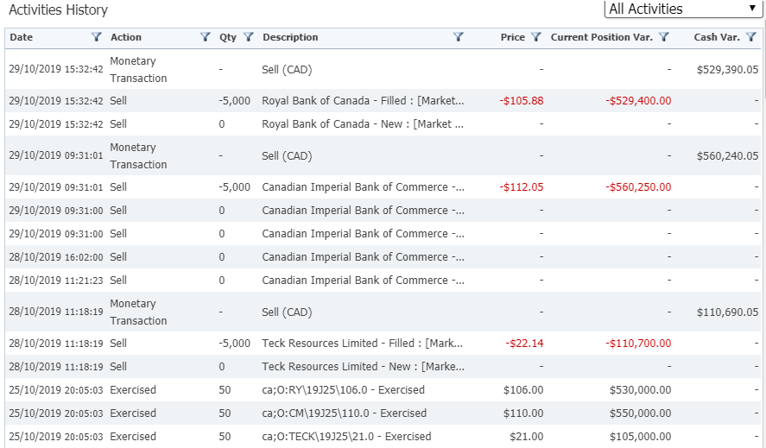
Refresher on OUR Positions from Last WEEK:
Net Debits for each position:
CM: -7909.95
RY: -6659.95
TECK: -5109.95
Cash Flow Upon Expiry:
CM: -550000
RY: -530000
TECK: -105000
Cash Flow Upon Position Close:
CM: +560240.05
RY: +529390.05
TECK: +110690.05
Bottom Line:
CM: + $2330.10
RY: - $7269.90
TECK: + $580.10
= - $4359.70
Notes:
Talk about if these were good decisions.

Slide 5

Margin call:
We cannot stay for multiple days
Negative cash flows:
Cannot stay like this for multiple days
They will liquidate our positions
We are allowed a maximum of 5 margin calls

Slide 6
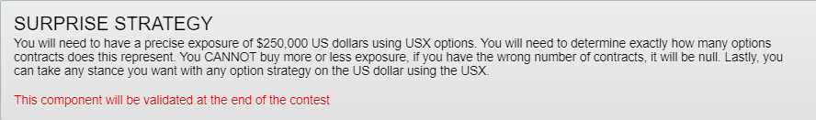
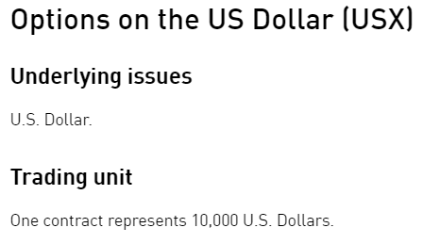
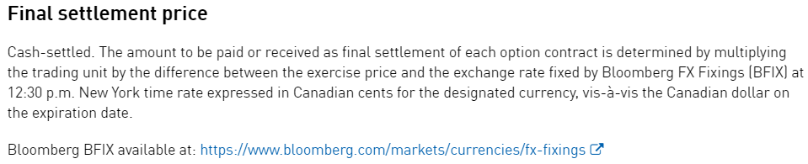
New mandatory strategy
What does this mean? What is exposure?

Slide 7
Final thoughts and Key Takeaways:
Let’s decide on some trades for this week. Does everybody have their pitches ready?
We need to know how the USX options work as it is a requirement. Better to not waste money trying to fulfill the requirement too
Notes:
Where should they be uploaded? Google drive? Facebook?

